Slide 1

Comprehensive Digital Marketing
Project Work

Slide 2
THE TEAM MEMBERS ARE :
Gorapalli Navya : 720131605214 ( Team leader )
Dhamarasingh Bhavani Devi : 720131605209
Digumarthi Niharika : 720131695210
Devakota Bhuvaneswari : 720131605208
Dokkari. Akhila : 720131605211
Notes:
TEAM MEMBERS

Slide 3

Part 1: Brand study, Competitor Analysis & Buyer’s/Audience’s Persona
. Research Brand Identity: Study the brand‘s mission, values, vision, and unique selling propositions (USPs).
Mission/Values:
Himalaya as a science-based, problem-solving, head-to-heel brand, harnessed from nature's wealth and characterized by trust and healthy lives. Himalaya is a nature’s finest , time-tested formulas and ethical sourcing.
Brand Colours:
Classical Himalaya teal and green.
logo:
USP:
The USP of Himalaya herbals is to offer a unique blend of ancient wisdom, modern science and a commitment to sustainability, making them a preferred choice for those seeking natural and reliable wellness solutions.
Tagline: Naturally powerful, purely Himalaya
.

Slide 4
Part 1: Brand study, Competitor Analysis & Buyer’s/Audience’s Persona
Analyze Brand Messaging:
Brand message: ‘Embrace Nature’s Healing Touch with Himalaya Herbal.
1. Nature-Centric Approach: The brand message emphasizes a nature-centric approach, positioning Himalaya Herbal as a brand that harnesses the healing power of natural ingredients. It communicates that the products are rooted in the wisdom of nature, appealing to consumers seeking natural and holistic solutions for their health and wellness need.
2. Healing and Wellbeing: The term "Healing Touch" in the brand message evokes a sense of wellness and healing, suggesting that Himalaya Herbal products are designed to address various health concerns and promote overall well-being. It implies that the products are not just superficial solutions but go deeper to support the body's natural healing processes.
Notes:
Ok

Slide 5
3. Embrace and Inclusivity: The word "Embrace" in the brand message implies an open and inclusive approach. It suggests that the brand welcomes consumers from all walks of life to experience the benefits of their herbal products. This inclusivity can resonate with a diverse audience and foster a sense of connection with the brand.
4. Trust in Herbal Remedies: By associating with the term "Herbal," the brand message reinforces the notion that Himalaya products are derived from natural plant-based ingredients. It taps into the growing consumer interest in herbal remedies, which are often perceived as safe and gentle alternatives to synthetic products.
.
5. Emotional Appeal: The brand message evokes emotions such as comfort, reassurance, and the idea of getting back to nature's roots. It taps into consumers' desire for simplicity, purity, and a return to traditional healing methods, providing a sense of relief in an increasingly fast-paced and complex world.
6. Brand Essence: The brand message encapsulates the core essence of Himalaya Herbal products, which is the synergy between nature's wisdom and the brand's scientific approach. It positions Himalaya as a trusted and reliable source for natural wellness solutions backed by research and development.
Notes:
Brand messa

Slide 6

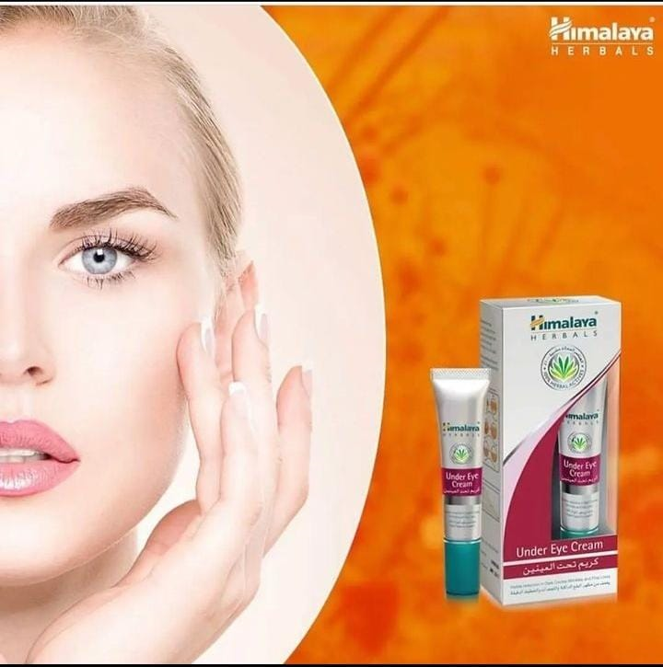
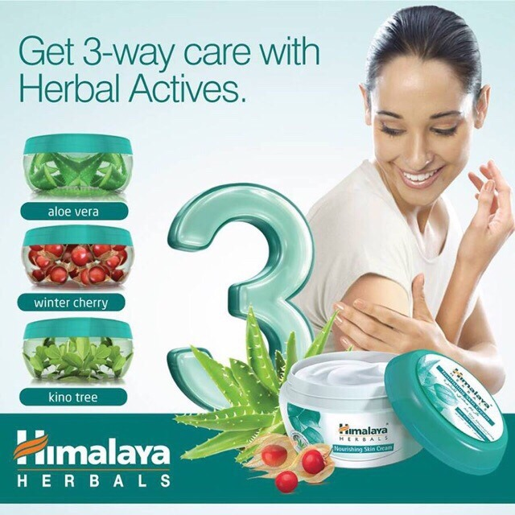
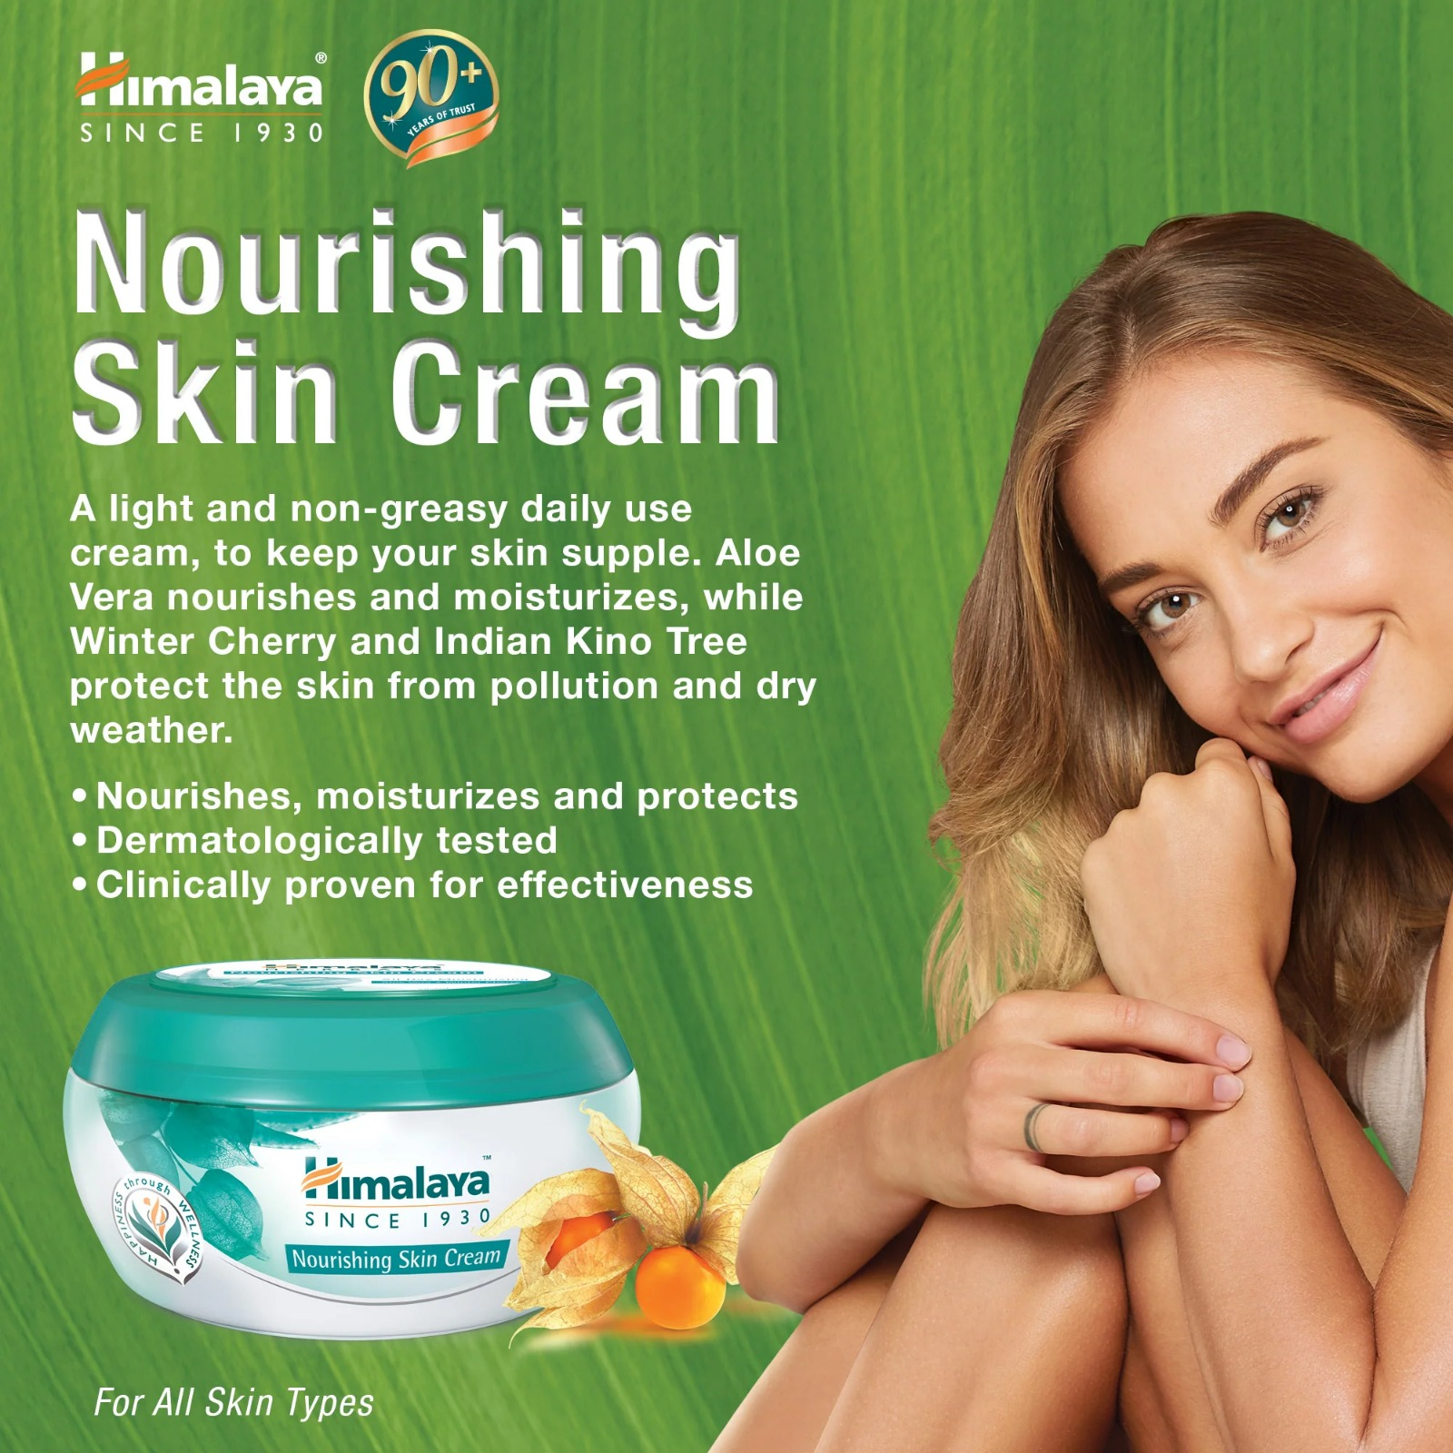
. Brand messaging :
“Wellness in every home , Happiness in every heart’’.
Formal , fun and highly informative .
Consumer friendly – uses real consumer reviews and feedbacks so as to product as
Well as make any improvements if need be.
Guides consumers to select the right product for their requirements.
Provides health and self care awareness.
https://instagram.com/himalaya_herbs?igshid=MzRlODBiNWFlZA==
https://instagram.com/himalayaherbalindia?igshid=MzRlODBiNWFlZA==
https://instagram.com/himalayaherbalskenya?igshid=MzRlODBiNWFlZA==
Notes:
“wellness in every home , happiness in every heart”.

Slide 7
.Examine the brand’s tagline:
One of the well-known taglines used by Himalaya Herbal Healthcare is:
"Promoting Health & Wellness Since 1930
"This tagline reflects their long-standing commitment to offering herbal products that promote health and well-being. Himalaya Herbal Healthcare is a company known for its wide range of natural and herbal products, including skincare, personal care, and wellness products. Their products are formulated using traditional Ayurvedic principles combined with modern science.
The Himalaya Drug Company was founded by Mohammad Manal, a nature lover, in Dehradun in the 1930s. Manal had the goal of commercialising Ayurvedic and herbal products to suit contemporary needs, by focusing on modern empirical research to demonstrate their efficacy.The company moved to Bombay (Mumbai) in the 1950s. In 1955, it launched 'Liv.52', a hepato-protective, that became the flagship product of the company.In 1975, Meraj Manal, Mohammad Manal's son, started a manufacturing unit in Bangalore, which helped the company grow its manufacturing capacity as well as to globalise.
:
CONCLUSION: Himalaya Drug Company is the oldest Ayurvedic drug manufacturing company in the India. It deals in both Pharma and FMCG (cosmetics) both. In the available Pharma range Himalaya is the most reputed company. Himalaya mainly beliefs and engage in ethical promotion to doctors.
Notes:
Examine the brand’s tagline

Slide 8
Part 2: SEO & Keyword Research
SEO Audit: Do an SEO audit of the brands website
Keyword Research: Define Research Objectives, Brainstorm Seed Keywords, Utilize Keyword Research Tools (SEMrush or Moz Keyword Explorer),Analyze Competitor Keywords, Long-tail Keyword Exploration (specific, longer phrases) that align with the research objectives and have lower competition but higher conversion potential.
On page Optimization: Meta Tag optimization & content optimization
Reflect on the process of conducting keyword research and the SEO recommendations provided.
Document the challenges faced during the research and analysis phase, as well as the key insights gained from the keyword research process.

Slide 9
SEO Audit
1. *Keyword Analysis*: Check the website's keywords to ensure they align with the content and target audience.
2. *On-Page SEO*: Review title tags, meta descriptions, headings, and content to optimize relevancy and keyword usage.
3. *Technical SEO*: Check for crawl errors, broken links, XML sitemap, and robots.txt to ensure proper indexing.
4. *Site Speed*: Evaluate the website's loading spee and optimize where necessary for better user experience and search rankings.
5. *Mobile-Friendliness*: Ensure the site is responsive and displays well on different devices.
6. *Backlink Analysis*: Assess the website's backlink profile and ensure the links are from reputable sources. t
.
7. *Social Media Integration*: Check if the site is connected to relevant social mnavigation, design, and overall user experience to improve site usabiliyedia platforms.
8. *Content Quality*: Evaluate the overall content for uniqueness, relevance, and engagement.
9. *User Experience*: Review navigation, design, and overall user experience to imdprove site usability.
10. *Local SEO*: If applicable, verify that the site is optimized for local searches.

Slide 10
Keyword Research
1. *Understand Your Products*: Familiarize yourself with the Himalaya herbal products you want to target. Know their names, benefits, and specific uses.
2. *Brainstorm Seed Keywords*: Start with broad seed keywords related to Himalaya herbal products, such as "Himalaya herbal products," "Himalaya supplements," "Himalaya skincare," etc.
3. *Use Keyword Research Tools*: Utilize keyword research tools like Google Keyword Planner, SEMrush, or Ubersuggest to find related keywords and their search volumes.
4. *Long-Tail Keywords*: Look for long-tail keywords that are more specific and targeted, such as "Himalaya Ashwagandha capsules," "Himalaya Neem face wash," etc.
5. *Competitor Analysis*: Analyze your competitors' websites to see what keywords they are targeting for Himalaya herbal products.
6. *Search Intent*: Consider the search intent behind each keyword. Are users looking for information, reviews, or buying intent? This will help you align keywords with appropriate content.
7. *Local Keywords*: If Himalaya products are available in specific regions, include local keywords like "Himalaya herbal products in [location]."
8. *User Language*: Use language that resonates with your target audience and reflects how they may search for Himalaya products.

Slide 11
Part 1: Brand study, Competitor Analysis & Buyer’s/Audience’s Persona
Competitor Analysis: Select three competitors operating in the same industry or niche as the chosen brand, examine their USPs and online communication.
Competitor 1: https://www.myntra.com
USP: Cost leadership or product differentiation.
Communication : It uses a wide range of advertisements and campaigns.
Competitor 2 : https://www.amazon.in
USP : Increased visibility and improved credibility.
Communication : It uses wide variety of channels communication both analog & digital.
Competitor 3 : https://www.nykaa.com
USP : The right selection for their beauty and wellness needs.
Communication : Uses blogs , and targeted ads on its main platforms to increase online
sales.

Slide 12
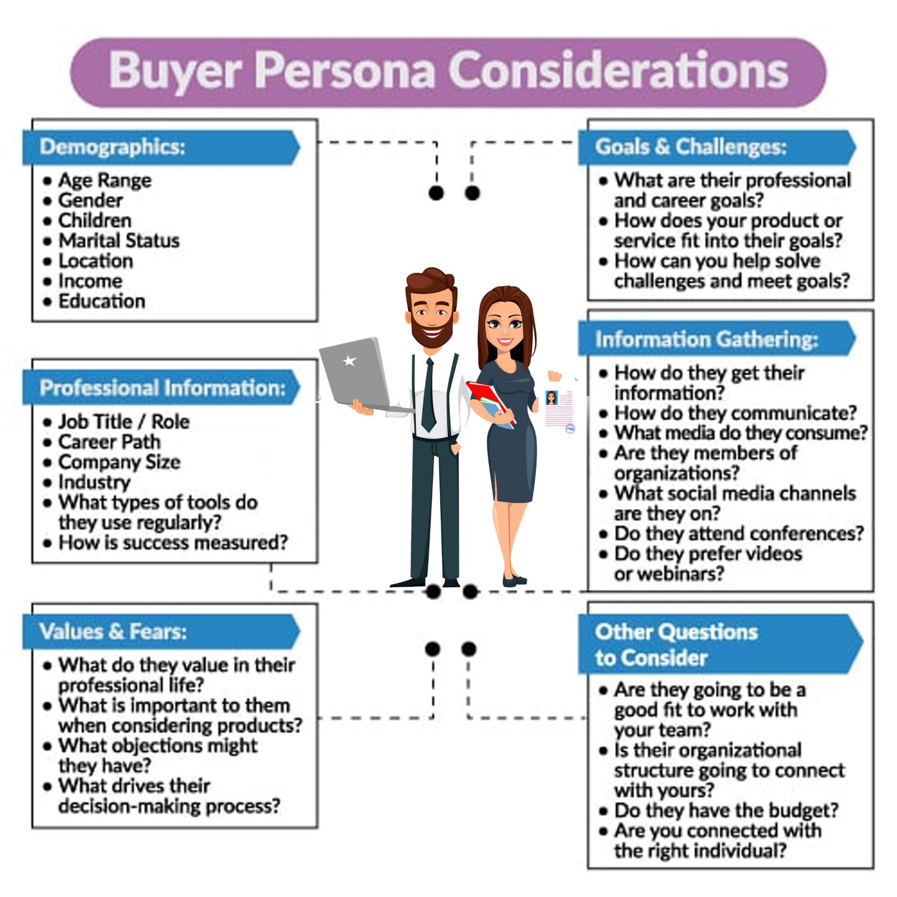
Part 1: Brand study, Competitor Analysis & Buyer’s/Audience’s Persona
Buyer's/Audience's Persona: Clearly define the target audience for the chosen brand. Consider demographics, psychographics, behaviors, and interests.
Himalaya herbals:
24
Men
Yes
Not married
Metro cities like hyderabad
Tier 2 and tier 3 cities
450000 per annum – 600000 per annum
Atleast 10+ 2
Ads youtube , instagram,community platforms like
Tv , twitter
Social status ,personal appearance
Incomplete ingredient list , quality.

Slide 13
Buyer Persona for Himalaya Herbal Product
:Name: Sarah Wellness-Seeker
Age: 32
Occupation: Marketing Professional
Location: Urban area in the United States
Marital Status: Single
Interests: Yoga, meditation, natural remedies, and healthy lifestyle
Goals: To maintain overall well-being, reduce stress, and boost immunity
Challenges: Dealing with occasional stress from a demanding job, finding natural remedies for common health issues, and navigating through various wellness products in the marketPreferred Shopping Behavior: Prefers online shopping due to convenience and easy access to product information
Spending Habits: Willing to invest in high-quality herbal products that align with her values and provide proven health benefits
Information Sources: Trusts reputable health and wellness websites, reads reviews and ratings, and seeks recommendations from friends and social media groups focused on natural remedies and holistic health
Brand Perception: Looks for brands with a strong commitment to natural ingredients, sustainability, and ethical practices
Note: The buyer persona provided here is a fictional representation based on common characteristics of consumers interested in natural and herbal products. The actual buyer personas for Himalaya Herbal products may vary depending on the target market and specific product offerings. Companies like Himalaya often conduct in-depth market research to understand their audience better and tailor their marketing strategies accordingly.

Slide 14

Part 3: Content Ideas and Marketing Strategies
Content Idea Generation & Strategy: Create a content calendar for the remaining month of July by brainstorming content themes, exploring various formats like blog posts, videos, infographics, podcasts, and interactive quizzes, and scheduling publication dates mainly on Facebook & Instagram. And include the strategy, aim and the idea behind these posts and story
Content Calendar Example (Try creating a table for the month of August)

Slide 15
Part 3: Content Ideas and Marketing Strategies
Reflect on the content ideas and marketing strategies process, discussing the challenges encountered and lessons learned.
Himalaya Herbal Products are known for their natural and effective solutions derived from herbs and plants. To create compelling content and marketing strategies for Himalaya herbal products, consider the following ideas:
1. Educational Content: - Create blog posts, videos, or infographics that explain the benefits and uses of specific Himalaya herbal products. Educate the audience about the science behind these herbs and how they work to address various health and skincare concerns.
2. Social Media Campaigns: - Run contests, giveaways, or challenges on social media platforms to encourage user engagement and attract new customers. Utilize hashtags related to herbal remedies and natural wellness.
e
3. Video Tutorials: - Produce video tutorials that demonstrate how to use Himalaya herbal products effectively for different purposes, such as skincare routines, hair care, or stress relief.
4. Collaborations with Health Professionals: - Partner with healthcare professionals, naturopaths, or holistic experts who can endorse the benefits of Himalaya herbal products from a medical standpoint.

Slide 16
5. Product Comparisons: - Develop content that compares Himalaya herbal products with other conventional or natural products in the market. Highlight the unique features and benefits of Himalaya products to demonstrate their superiority.
6. Influencer Collaborations: - Partner with influencers and experts in the health and wellness niche to promote Himalaya herbal products. Influencers can create engaging content and reviews to reach a broader audience.
7. Seasonal Promotions: - Tailor marketing campaigns around seasons and events where specific Himalaya products can be highlighted. For instance, promoting immunity-boosting products during flu season or skincare products for summer skincare routines.
8. Customer Loyalty Programs: - Implement loyalty programs to reward repeat customers and encourage them to share their experiences with friends and family.
9. Virtual Events and Webinars: - Host virtual events and webinars with experts discussing the importance of natural products, herbal remedies, and the science behind Himalaya herbal products.
Remember, authenticity and transparency are crucial in marketing natural products. By focusing on the unique qualities of Himalaya herbal products and the values of the brand, you can effectively connect with your target audience and build a loyal customer base.

Slide 17
the challenges encountered and lessons learned.
Challenges encountered by herbal product companies:
1. Regulation and Compliance: Herbal products are subject to varying regulations and standards in different countries, and ensuring compliance with these regulations can be challenging.
2. Quality Control: Maintaining consistent quality and potency of herbal ingredients can be difficult due to factors like sourcing, processing, and environmental variations.
3. Research and Validation: Establishing scientific evidence to support the efficacy and safety of herbal products can be time-consuming and costly.
4. Competition: The herbal products market can be highly competitive, and companies may struggle to differentiate themselves and gain market share.
5. Consumer Perception: Some consumers may be skeptical about the effectiveness of herbal products compared to conventional medicines, which can impact sales.
6. Sustainability: Sourcing herbal ingredients sustainably and ethically can be a challenge, especially when demand for certain herbs increases.

Slide 18
Lessons learned :
1. Regulatory Awareness: Herbal product companies must stay informed about the regulatory requirements in their target markets and proactively comply with them.`
2. Emphasis on Quality: Prioritizing rigorous quality control measures helps maintain consistency and consumer trust in the products.
3. Research Investment: Investing in scientific research and clinical trials to validate product claims can enhance credibility and differentiate products in the market.
4. Market Strategy: Developing a clear marketing and positioning strategy helps companies stand out from competitors and connect with their target audience.
5. Education and Communication: Companies should focus on educating consumers about the benefits and uses of herbal products to address skepticism and build confidence.
6. Sustainability Initiatives: Implementing sustainable sourcing practices and promoting eco-friendly initiatives can resonate with environmentally conscious consumers.
It's important to note that the specific challenges and lessons learned for Himalaya Herbal products may differ based on their unique business strategies, product offerings, and market presence. For accurate and up-to-date information, it's best to refer to official company sources or recent reports.

Slide 19
Part 4: Content Creation and Curation (Post creations, Designs/Video Editing, Ad Campaigns over Social Media and Email Ideation and Creation)
Post Creation:
Select Content Categories: Identify three different content formats relevant to the chosen topic or industry. Research and Brainstorm: Research trending topics, industry news, or audience interests within each category. Brainstorm ideas for social media posts that align with each category. Do note that 1 content format has to be video and additionally 3 stories/status are to be created.
Format 1 : Blog article
Format 2 : video
Format 3 : creative

Slide 20
Part 4: Content Creation and Curation (Post creations, Designs/Video Editing, Ad Campaigns over Social Media and Email Ideation and Creation)
Format 1 : Blog article
Aim: Boost SEO & provide information about a certain new product
Date : 20th july 2023
Idea : Himalaya Wellness Company, the herbal health and personal care brand, announced the launch of its two new lip balm variants – Cherry Shine & Berry Shine Lip Balms.
Topic : 5 ways you can lipbalm this monsoon
It heals & soothes chapped lips and leaves my lips soft, smooth and nourished. It doesn't feel sticky or oily on the lips and you can use it underneath matte lipsticks.
Notes:
Format 1 : Blog article

Slide 21
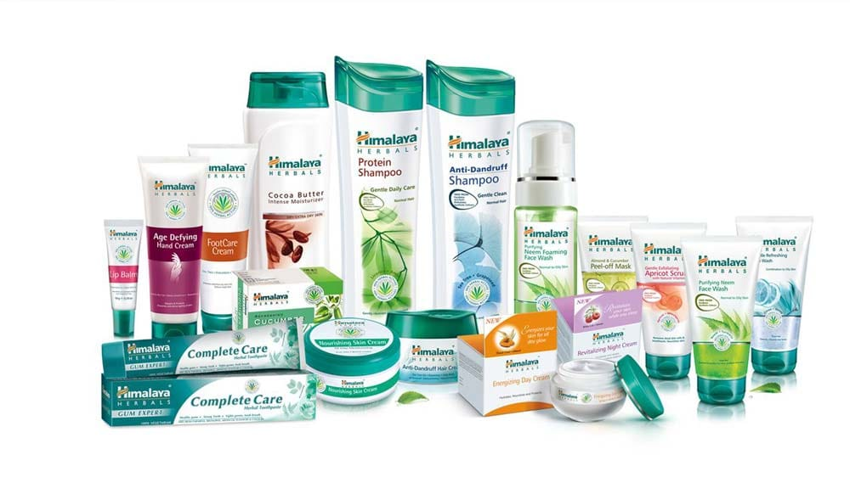
Part 4: Content Creation and Curation (Post creations, Designs/Video Editing, Ad Campaigns over Social Media and Email Ideation and Creation)
Format 2 : Video
Aim : To promote the Himalaya herbal products throght out the world.
Date : 23rd july 2023
Idea: Himalaya have launched newly skin care, hair care and wellness products .
Topic : Brand awareness.

Slide 22
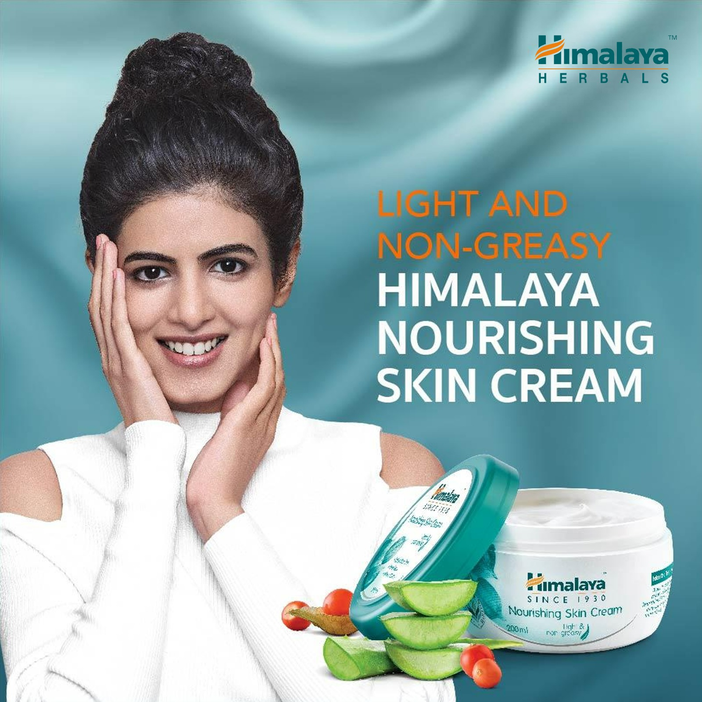
Part 4: Content Creation and Curation (Post creations, Designs/Video Editing, Ad Campaigns over Social Media and Email Ideation and Creation)
Format 3 : Creative
Aim : Brand awareness & reach
Date : 25th july 2023
Idea : To create a meme on a trending topic .
Topic : Customer satisfaction.
Notes:
Topic

Slide 23
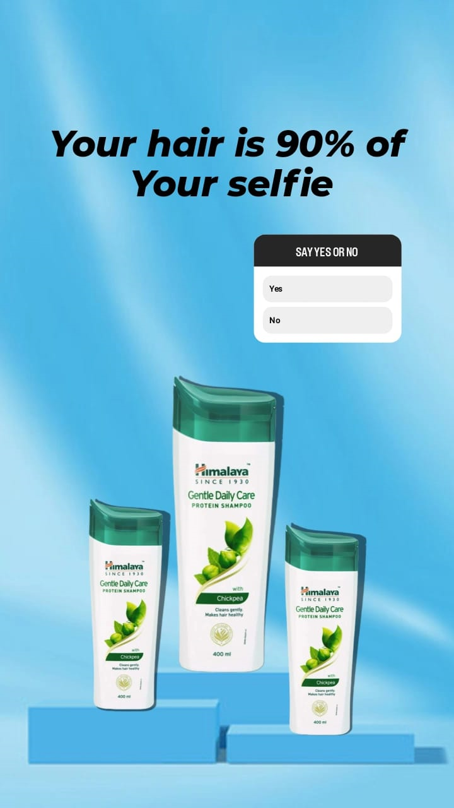

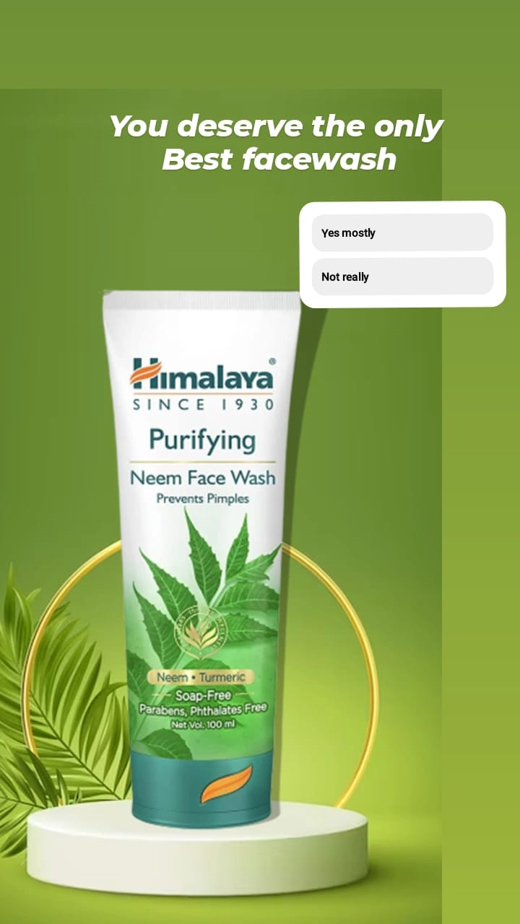
Part 4: Content Creation and Curation (Post creations, Designs/Video Editing, Ad Campaigns over Social Media and Email Ideation and Creation)
Instagram Story

Slide 24

Part 4: Content Creation and Curation (Post creations, Designs/Video Editing, Ad Campaigns over Social Media and Email Ideation and Creation)
Designs/Video Editing
Design Tools Familiarization (use Canva for creating visually appealing graphics)
Video Creation: Utilize VN or any video editor of your choice to create videos related to the chosen topic.

Slide 25
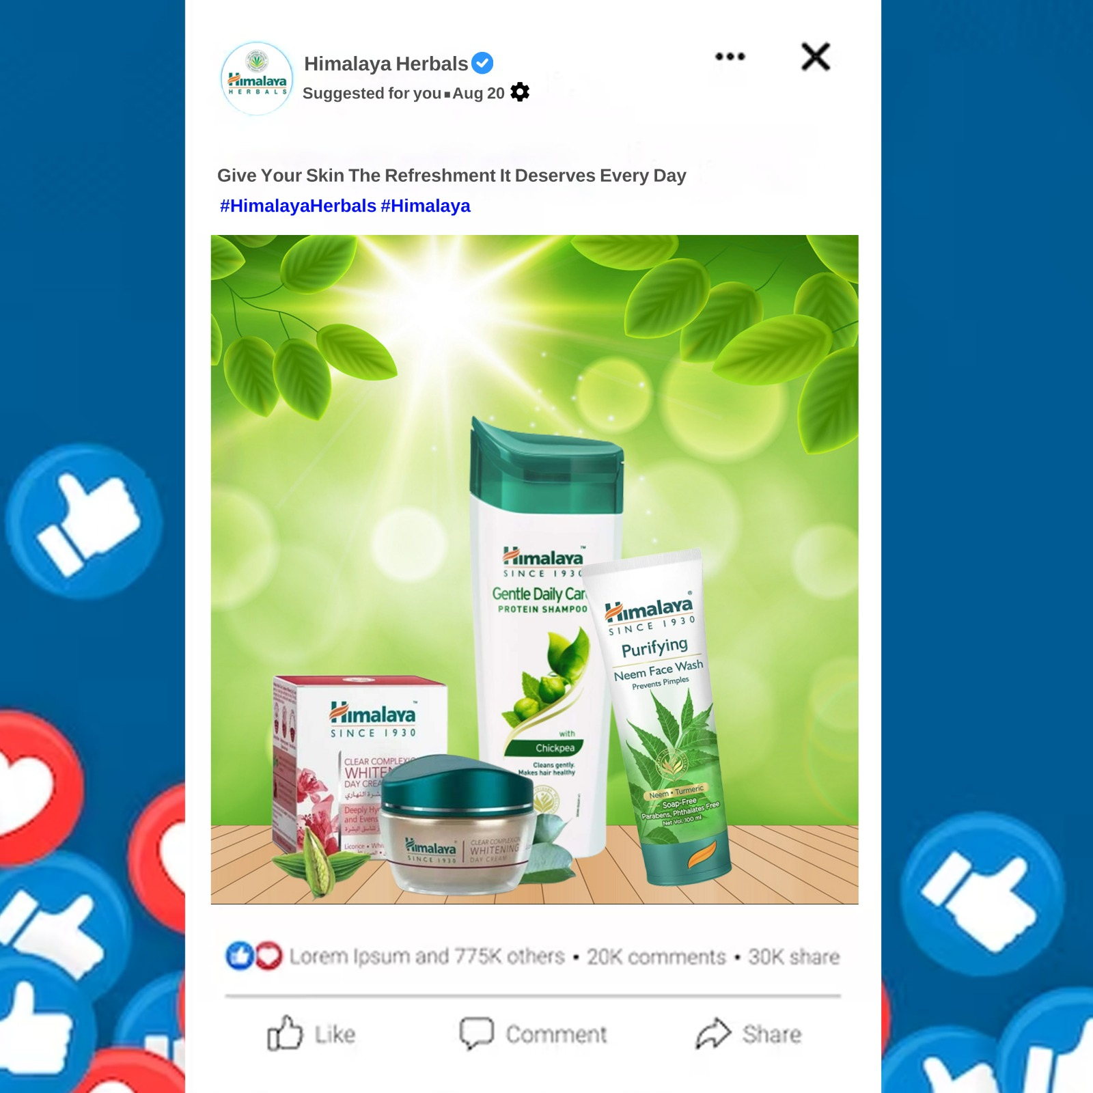
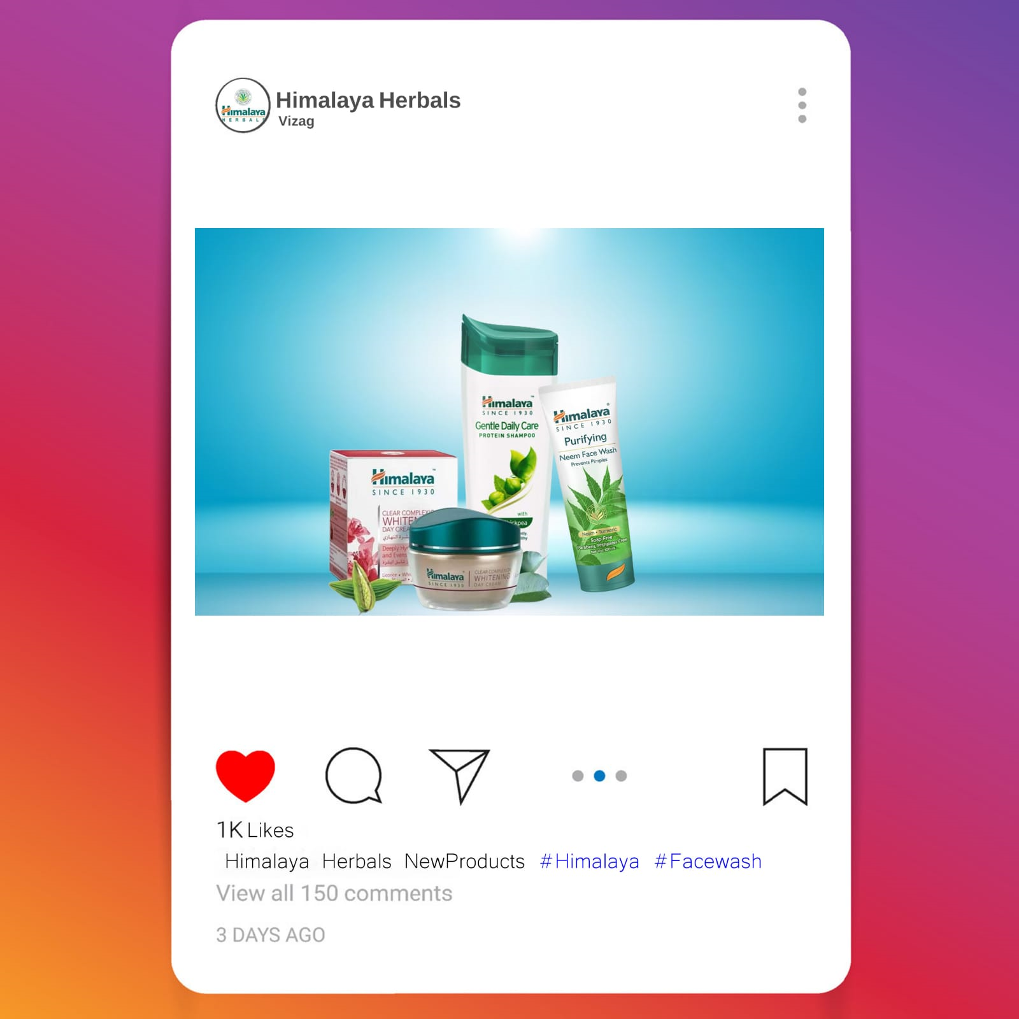
Part 4: Content Creation and Curation (Post creations, Designs/Video Editing, Ad Campaigns over Social Media and Email Ideation and Creation)
Social Media Ad Campaigns
Ad Campaigns over Social Media:

Slide 26
Part 4: Content Creation and Curation (Post creations, Designs/Video Editing, Ad Campaigns over Social Media and Email Ideation and Creation)
Email Ad Campaigns
Ad Campaigns for email marketing:
Come up with 2 email ad campaigns with the mentioned goals: brand awareness & generating leads

Slide 27
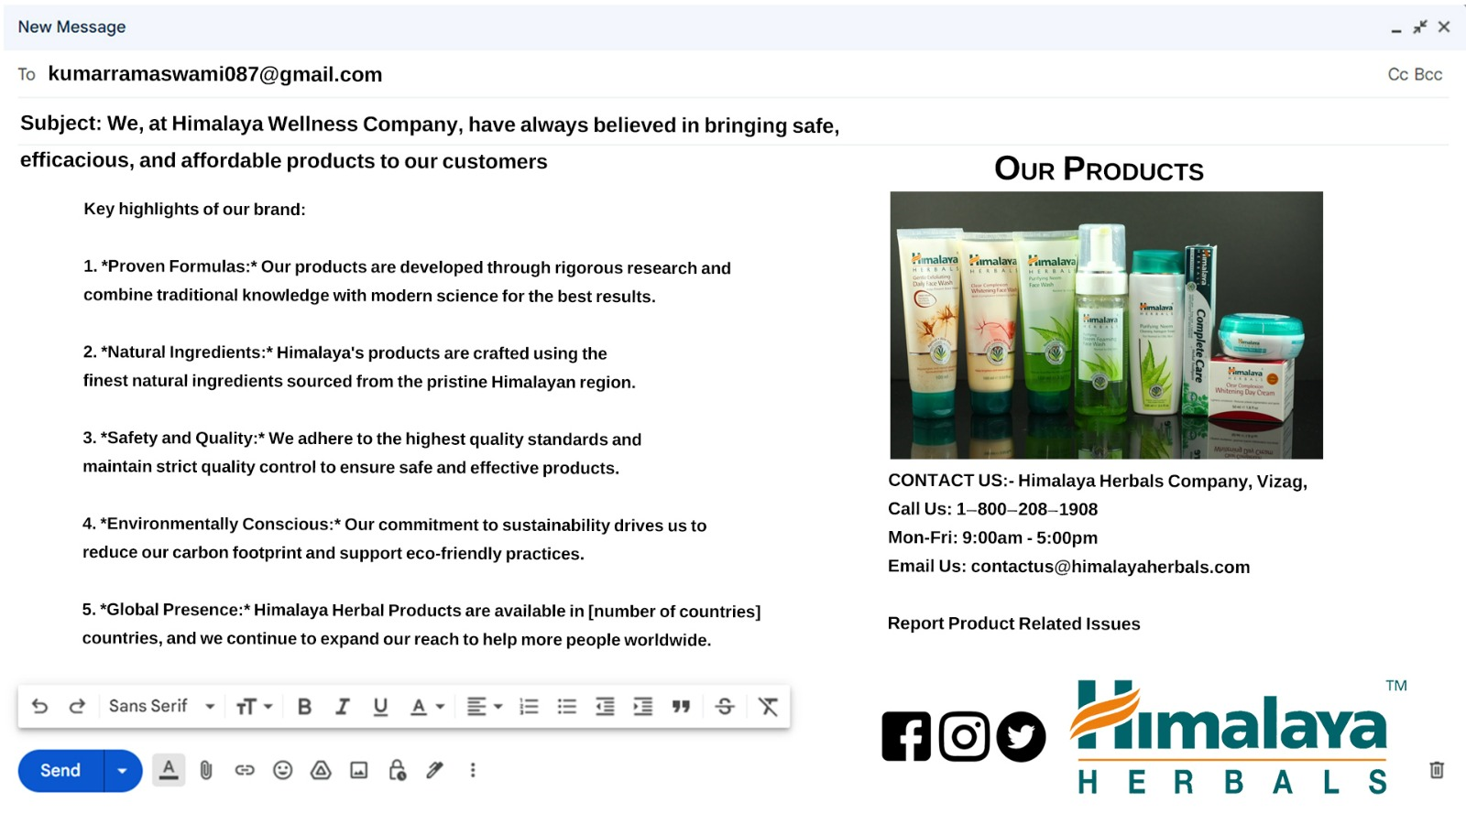
Email Ad Campaign 1 - Brand Awareness
(insert emailer image)

Slide 28
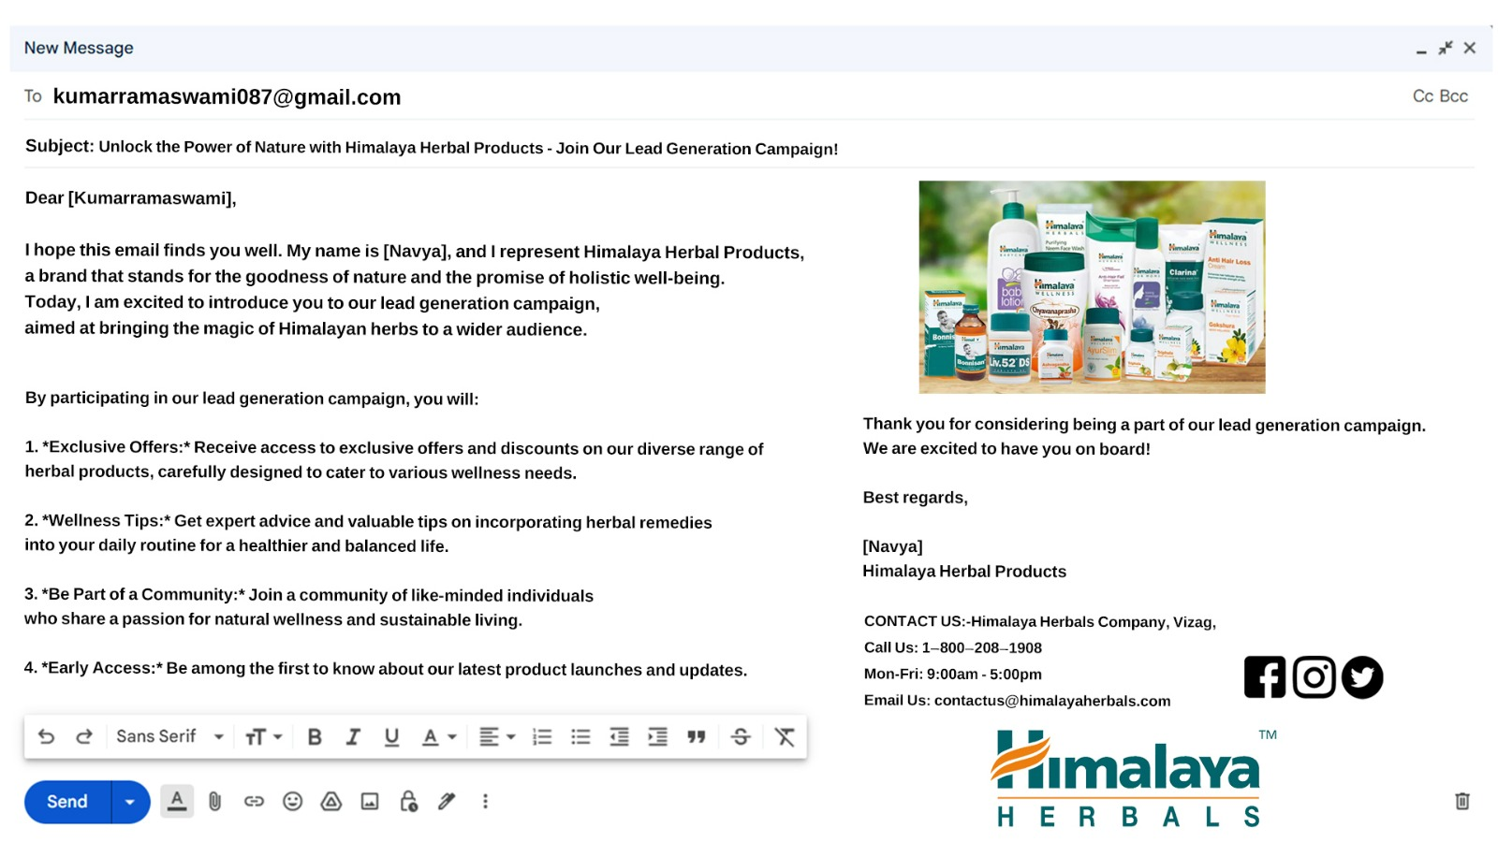
Email Ad Campaign 2 - Lead Generation

Slide 29
Part 4: Content Creation and Curation (Post creations, Designs/Video
Editing, Ad Campaigns over Social Media and Email Ideation and Creation)
Reflect on the content creation and curation process, discussing the challenges faced and lessons learned.
Creating and curating content for a Himalaya herbal product involves several steps to ensure that the content is informative, engaging, and aligns with the brand's values. Here's a step-by-step guide for the content creation and curation process:
1. Understand the Product and Brand: - Familiarize yourself with the specific Himalaya herbal product you're working on. Understand its ingredients, benefits, target audience, and unique selling points. - Gain a deep understanding of the Himalaya brand, its mission, values, and messaging guidelines.
2. Define the Content Objectives: - Determine the goals of the content. Are you aiming to educate customers, promote the product, or showcase its uses? Clear objectives will guide your content creation.
3. Identify the Target Audience: - Know who the content is intended for. Define the demographics, preferences, and pain points of the target audience to tailor the content accordingly.

Slide 30
4. Conduct Research: - Research the product's ingredients, benefits, and potential applications. Gather scientific data, customer reviews, and testimonials to add credibility to the content.
5. Content Formats: - Choose suitable content formats based on the audience and objectives. Content can include blog posts, social media posts, videos, infographics, product guides, and more.
6. Storytelling and Messaging: - Craft compelling narratives and key messages that resonate with the audience and highlight the product's unique selling propositions.
7. Compliance and Legal Review: - Ensure that the content adheres to all relevant regulations and doesn't make false claims. Comply with advertising and health regulations in the target markets.
8. Visual Assets: - Create or source high-quality images, graphics, and videos that complement the content and showcase the product's features effectively.
9. Creation and Review: - Develop the content following the planned formats and messaging. Review and edit the content for accuracy, clarity, and brand alignment.
Remember, consistency and authenticity are key to maintaining a strong brand presence. Always prioritize accurate information and customer satisfaction in your content creation and curation process for Himalaya herbal products.

